Slide 1
DESIGN AND IMPLEMENTATION OF A WEB-BASED FINAL YEAR PROJECT MANAGEMENT SYSTEM (FYPMS) (A CASE STUDY OF COMPUTER SCIENCE DEPARTMENT BABCOCK UNIVERSITY)
GROUP 14
IZEVBIZUA SAMUEL EDOSA 19/1084
ADEKOYA DAMILARE ANOINTING 19/0095
OMAGE OMOLE NATHANIEL 19/1200
UNDER THE SUPERVISION OF Dr. RUTH AMANZE

Slide 2
Introduction & Background
The use of web-based technologies in educational settings across the globe is constantly expanding, gradually eradicating challenges and the necessity for human labour. Online web-based technologies have made it simple to collaborate and share data, reduce development costs, centralize security and information availability, and boost productivity.
The traditional manual system used for final year project management and supervision is typically time-consuming and might not always be as effective as first intended.
The proposed FYPOMS (Final Year Project Online Management System) seeks to offer a web-based platform that will implement improved and consistent "supervision" between students and their designated supervisors in completing their final year projects.
The FYPOMS offers appropriate solutions to the prior systems used in managing final year projects.

Slide 3
Problem Statement
Project management at Babcock University's computer science department is carried out manually. The existing management method, while still achieving the expected goals, has several drawbacks, including:
The occasional supervisor or student absence from scheduled sessions might affect efficiency.
Because the manual system of monitoring the progress of individual students involves more labour and takes longer to operate, it is less effective.
In addition, there is no established method of accounting for software development and implementation process.

Slide 4
Objectives of the study
The primary objective of the suggested system is :
To offer a comfortable, effective, dependable, and user-friendly platform that will make project supervision between students and supervisors simple.
The suggested system's goals are to:
To configure the client-side (frontend) and server-side (backend) to support two interfaces, one for the supervisor and the other for the student.
To put in place a grading scheme based on pupil performance.
To provide modules for communication via message boards and links to online meetings.
To provide submission modules for various aspects of the project

Slide 5
Significance of the study
The study of the proposed FYPOMS is considered significant as the following will benefit from it:
The school: The school will gain a lot from the study of the suggested FYPMS since a web-based management system is practical from an economic standpoint and offers some level of accuracy.
The students: The setting will be more adaptable and pleasant for students to learn crucial 21st-century skills including communication, teamwork, and technological proficiency.
The Project Supervisors. This system will serve as a tool to better manage student performance and project work easily.
The Current Researcher: This study will give the researcher better insight about the current project management system.
The Future Researchers: This study will serve as a reference material for future research activities so as to aid the development of newer models of the existing system and communicate their views in the study they have selected.

Slide 6
Limitation of the study
The following are some research limitations:
This system will not use algorithms to pair supervisors with their students.
All of the school's departments will not be taken into account while designing and implementing the system.
This initial system It will be implemented and tested for thedepartment of Computer Science at the 400 level.
The initial system will be implemented for the support of two users: the students and supervisors in order to focus on the aspect of supervision.
Due to time constraints and other limitations, all defined system requirements may not be fully met.

Slide 7
Methodology Overview
Materials used for implementing this application include but are not limited to:
MongoDB: MongoDB will be used as the database system.
JavaScript: This is the scripting/programming language that will be used to implement the frontend and backend functionalities.
Postman: This is an API testing platform that will be used to test APIs upon application development.
Visual Studio Code: This software will be used to write code in the system development process.
Edraw-Max: This software will be used to design, UML diagrams, use case diagrams and system flow charts.
Toad Data Modeler: This software will be used to design the database Enhanced Entity Relationship Diagram (EERD).
Microsoft Word: This software is used to create project documentation.

Slide 8
Methodology Overview
This is a web-based application, programming at the client-side and server-side will be done using JavaScript, while MongoDB will be used as its database.
The supervisor and the student are the two essential entities that are involved in the system overview.
Modeling the system is the first stage in the product development process. Using software such as toad data modeler, entity relationship diagrams for the MongoDB database will be created. UML diagrams will also be used to depict the algorithmic workflow of different system capabilities.
The second stage will be creating the application. In this stage, Visual Studio Code will be used to write and execute JavaScript codes for the application's front-end and back end.
The application will be tested in an effort to address any issues or unsatisfied user needs that might emerge.

Slide 9
Literature Review - Overview of Existing System
In the current system, the head of department office is the centre of project management which is responsible for assigning a supervisor to each student, preparing and providing project schedules, scheduling and arranging project presentations, collecting the final project dissertation, and recording the students' grades. Throughout the project, students must constantly meet, and each meeting must be documented in the log books and approved by the supervisors.
Currently, supervision of projects involves the use of log books by supervisors to keep track of the development of students' projects and document all necessary events or actions taken while supervising them. Occasional physical meetings are organised between students and their supervisors to also monitor the project dissertation process.
The log book’s inability to tracking software development progress is a limitation to the use of this manual method of managing student projects .

Slide 10
Literature Review – Review of related works
STAFF TO STUDENT INTERACTIVE PLATFORM
(Manir, 2017) authored an article on the use of the Internet for interactive learning, teaching, and research. According to his survey, 50% of teachers used the internet for interactive research while 40% of students used it for interactive learning. However, none of the teachers utilized it for interactive teaching.
An interactive Internet-Based System was designed by Khane et for the HCL CDC. A variety of modules were used, including practice, test, milestone, profile, and chat modules in the system to offer interaction. The creation and implementation of this system was later carried out by Hyosook Jung in 2019.
(Yoon, 2017) came to the realization that the Web's (the World Wide Web) use had greatly improved the educational system. He proposed a web project learning model based on constructivist principles, to provide motivation and collaborative learning for students in the Web environment. He put the model into action and demonstrated how it can be used in environmental education, as an example Gallian (2016) created a system to keep students engaged in an Online Tutoring System at all times.

Slide 11
Literature Review – Review of related works
THE NEED FOR A FINAL YEAR PROJECTS MANAGEMENT SYSTEM
According to (Aliyinza, 2017), students at the college of computing and information sciences develop projects during their final year as a requirement for finishing their program.
A survey was carried out to study the current system. The purpose of the survey was to learn about the difficulties supervisors, coordinators, and students encounter when working on final year projects. From a total of about 24 supervisors, a sample of 10 supervisors was chosen (six from each program).
The findings showed that due to hectic, supervisors are unable to monitor each group's progress individually.
Students requested that a platform that records general topics discussion forum, tracks student supervisor communication, and enables projects to be uploaded be put in place.
Another recommendation offered by students for enhancing accessibility was the flexibility to edit group information and archive work.
Supervisors pointed out that, a system that enables them to evaluate deliverables online will greatly cut down on the time and cost associated with printing.

Slide 12
Literature Review – Gaps to the Study
To introduce some level of improvements to the current systems, the following gaps have been identified through the study of the reviewed literature.
Little to no emphasis was made on providing modules for sharing software development repositories.
Providing modules for submitting deliverables should be sub-divided into stages inn order to improve performance evaluation accuracy through provision of sub-modules for each submission.
Providing a grading module where student performance can be associated with points.
This system will provide modules that will meet the outlined gaps.

Slide 13
System Analysis and Design – Research Design
The Iterative model will be used because of its tendency to produce early and periodic results, it is easy to measure software development progress, it has a less expensive effect on incorporating modifications at this early stage of software development/implementation, and it is easier to manage risks. The iterative process involves a continuous cycle of planning, analysis, implementation, testing and evaluation.
PLANNING: A timeframe and plan for the initial iterative cycle are made, together with an explanation of the fundamental needs.
ANALYSIS: Models and technical requirements will be generated together with a working schematic that satisfies the requirements after identifying system needs and conducting some feasibility analysis.
IMPLEMENTATION: During this phase, code execution will be used to create the required design and system functionalities.
TESTING: During this phase, errors are found and acknowledged so they can be corrected and system requirements can be more precisely met.
EVALUATION: Project stakeholders assess the project's current status and contrast this iteration with the specifications and goals set out.

Slide 14
System Analysis and Design
FUNCTIONAL REQUIREMENTS
Signup modules.
Login modules.
The supervisor dashboard module.
The student dashboard module.
Supervisor views.
Student views.
Project progress module.
Grading module.
Software sharing module.
Submission module.
NON-FUNCTIONAL REQUIREMENTS
Each project super-stage will have time spans attached to them for due completion.
The points in the grading module can later be converted to a form of CA at the decision of the department.
The software sharing module will only provide a platform to share code repository links such as GitHub.

Slide 15
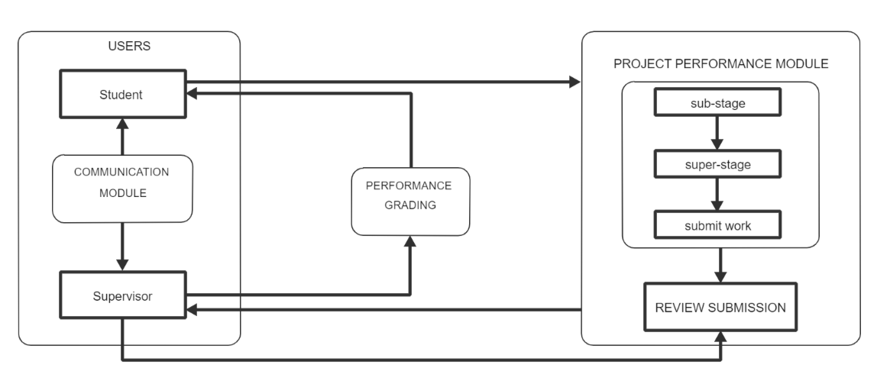
System Analysis and Design – Model Diagram

Slide 16
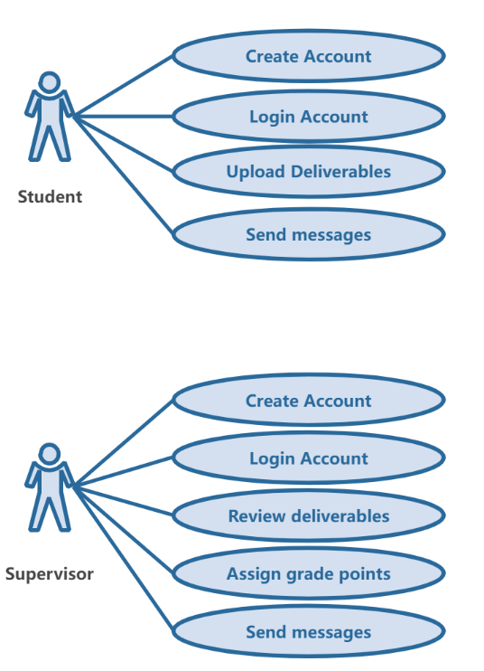
System Analysis and Design – UML Use Case Diagram

Slide 17
Implementation Overview
This is a web-based application i.e. it will be implemented on a website and will require some technical expertise on web development for the client-side and server-side.
The server-side
JavaScript and Express will be used as the back-end framework.
MongoDB will be used as the database system.
The server-side will aim to configure the database models and create APIs to which data will be interacted with at the client-side.
Postman will be used to test these APIs upon application development.
The client-side
JavaScript will be used as its core scripting language.
React JS will aid the development of the Single-Page-Application (SPA) which will aid easy routing and navigation on the website.
The user-interface will be designed and data from the server-side APIs will be used to display information on the client-side that meet system requirements.
After development of the website. Testing will be done on the finished work before deciding if all necessary system requirements are met and ready to be deployed.

Slide 18
CONCLUSION
The current system of managing final year projects at Babcock University is majorly implemented with manual methods of supervision.
The proposed study plans to partially eliminate the current manual system used as some aspect of manual labour are still needed to achieve the overall system solutions.
The primary goal of this project is to provide a comfortable, effective, dependable, and user-friendly platform that will make project supervision more effective and simple.

Slide 19
References
Leung, C. H., Lai, C. L., Yuan, T. K., Pang, W. M., T. Tang, J. K., Ho, W. S., & Wong, T. L. (n.d.). The Development of a Final Year Project Management System for Information Technology Programmes. The Development of a Final Year Project Management System for Information Technology Programmes | SpringerLink. https://link.springer.com/chapter/10.1007/978-3-662-46158-7_9
Jung, H., Jun, W., & Gruenwald, L. (2001, July). A design and implementation of web-based project-based learning support systems. In International Conference Human Society@ Internet (pp. 354-367). Springer, Berlin, Heidelberg.
Design and implementation of a web-based final year students research project supervision management system. (n.d.). Design and Implementation of a Web-based Final Year Students Research Project Supervision Management System. https://www.classgist.com/projectdetails.aspx?id=745
Bakar, M. A., Jailani, N., Shukur, Z., & Yatim, N. F. M. (2011). Final year supervision management system as a tool for monitoring Computer Science projects. Procedia-Social and Behavioural Sciences, 18, 273-281.
Graf, Del Monte, Allendorff, Mendonca-McCoy, & R. VanLandingham. (n.d.). Student Tracking Systems Can Be Used to Enhance Graduation and Retention Rates. https://oppaga.fl.gov/Documents/Reports/06-48.pdf

Slide 20
References
H. Bers, E. T. (n.d.). ERIC - ED307925 - Using Student Tracking Systems Effectively. New Directions for Community Colleges, Number 66., New Directions for Community Colleges, 1989. ERIC - ED307925 - Using Student Tracking Systems Effectively. New Directions for Community Colleges, Number 66., New Directions for Community Colleges, 1989. https://eric.ed.gov/?id=ED307925
Mark, K. (n.d.). The Need For A Final Year Project Management System. (PDF) the Need for a Final Year Project Management System | Kajubi Mark - Academia.edu. https://www.academia.edu/73230906/The_Need_For_A_Final_Year_Project_Management_System
Ndupu, Ogege, & Ojoboorun. (2020). A Final Year Project Management System.
Ogbaudu, O. (2021). Design and Implementation of Staff to Student Interactive Platform.
All about the Iterative Design Process | Smartsheet. (2019, January 2). All About the Iterative Design Process | Smartsheet. https://www.smartsheet.com/iterative-process-guide

